Slide 1
2023/24
Computational Methods for Finance
Python - Basics II
Dr Yang Yue

Slide 2
Data Types and Structures

Slide 3
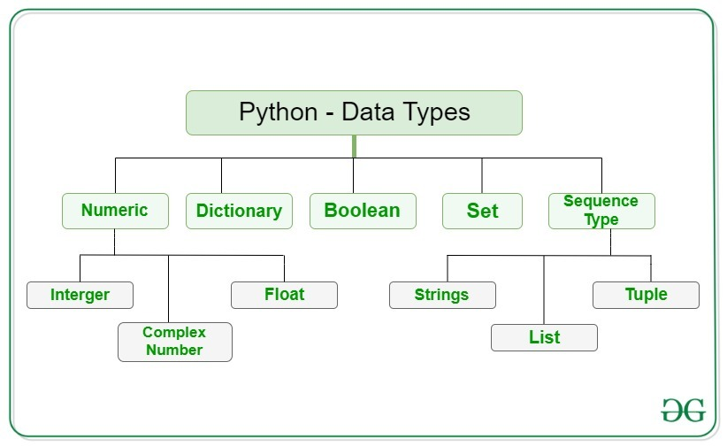
Data Types and Structures
Data Types
Object type | Meaning | Used for
int | Integer value | Natural numbers
complex | Complex value | Complex numbers
float | Floating-point number | Real numbers
dict | Mutable container | Key-value store
bool | Boolean value | Something true or false
set | Mutable container | Collection of unique objects
str | String object | Character, word, text
list | Mutable container | Changing set of objects
tuple | Immutable container | Immutable container
A good resource to learn Python basics: https://www.w3schools.com/python/default.asp

Slide 4
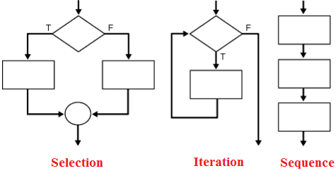
Data Types and Structures
Sequential
Sequential execution is when statements are executed one after another in order. You don't need to do anything more for this to happen.
Selection
Selection used for decisions, branching - choosing between 2 or more alternative paths.
if
if...else
switch
Repetition
Repetition used for looping, i.e. repeating a piece of code multiple times in a row.
while loop
do…while loop
for loop
Control Structures
Sequential
Selection
Repetition

Slide 5
Numerical Computing with ‘NumPy’

Slide 6
Numerical Computing with ‘NumPy’
Arrays of Data & Regular Numpy Arrays
Arrays with Python Lists
Arrays can be constructed with the built-in data structures presented in the previous chapter. list objects are particularly suited to accomplishing this task.
The Python array Class
There is a dedicated array module available in Python. According to the documentation: This module defines an object type which can compactly represent an array of basic values: characters, integers, floating point numbers.
numpy.ndarray is just such a class, built with the specific goal of handling n-dimensional arrays both conveniently and efficiently - i.e., in a highly performant manner.
A major feature of the ndarray class is the multitude of built-in methods.
Universal functions are another important feature of the NumPy package. They are “universal” in the sense that they in general operate on ndarray objects as well as on basic Python data types.
Reshaping and Resizing
Although ndarray objects are immutable by default, there are multiple options to reshape and resize such an object. While reshaping in general just provides another view on the same data, resizing in general creates a new (temporary) object.

Slide 7
Numerical Computing with ‘NumPy’
Vectorization of Code
Vectorization is a strategy to get more compact code that is possibly executed faster. The fundamental idea is to conduct an operation on or to apply a function to a complex object “at once” and not by looping over the single elements of the object. In Python, functional programming tools such as map() and filter() provide some basic means for vectorization. However, NumPy has vectorization built in deep down in its core.
Memory Layout
When ndarray objects When ndarray objects are initialized by using np.zeros(), as in “Multiple Dimensions”, an optional argument for the memory layout is provided. This argument specifies, roughly speaking, which elements of an array get stored in memory next to each other (contiguously). When working with small arrays, this has hardly any measurable impact on the performance of array operations. However, when arrays get large, and depending on the (financial) algorithm to be implemented on them, the story might be different. This is when memory layout comes into play.
Conclusion
NumPy is the package of choice for numerical computing in Python. The ndarray class is specifically designed to be convenient and efficient in the handling of (large) numerical data. Powerful methods and NumPy universal functions allow for vectorized code that mostly avoids slow loops on the Python level.
https://numpy.org/

Slide 8
Reading
Chapter 4 in Hipisch (2014)

Slide 9
THANK YOU
h.gong@westminster.ac.uk

